Slide 1
Hot Deals Platform
Fashion That Turns Heads
A Modern E-Commerce Solution with Loyalty Rewards

Slide 2
The Idea & Goal
The Idea: A specialized fashion e-commerce platform designed to simplify the shopping journey with a minimalist, product-focused interface.
The Goal:
To solve the complexity of traditional online stores by offering a clean, distraction-free User Experience (UX).
To build long-term customer relationships through an embedded, instant-reward loyalty system.

Slide 3
Team Members
Youssef Atef: Team Leader & Frontend Developer.
Philopater Wael: Frontend & Backend Developer
Youssef Waleer: Frontend developer
Ahmed Sobhy: Frontend developer

Slide 4
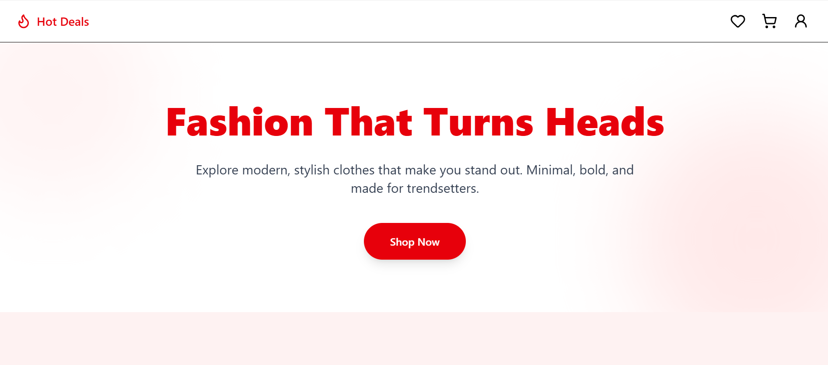
Modern UI & Experience
Minimalist Design: Clean interface focused on "Fashion That Turns Heads" branding
Responsive Layout: Fully responsive grid system ensuring compatibility across all devices.•

Slide 5
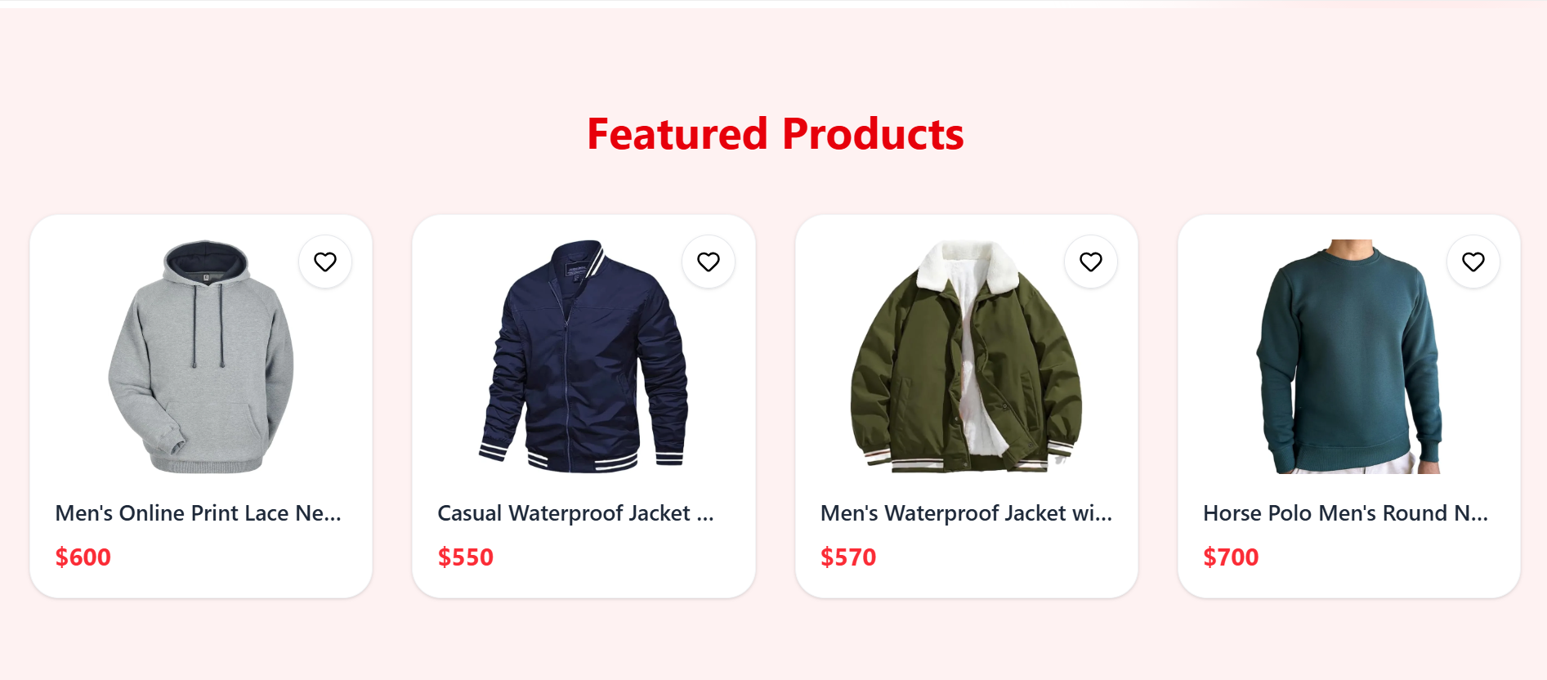
Featured Products
• Responsive grid layout.
• Quick 'Add to Cart' and 'Wishlist' features.
• Dynamic pricing display.

Slide 6
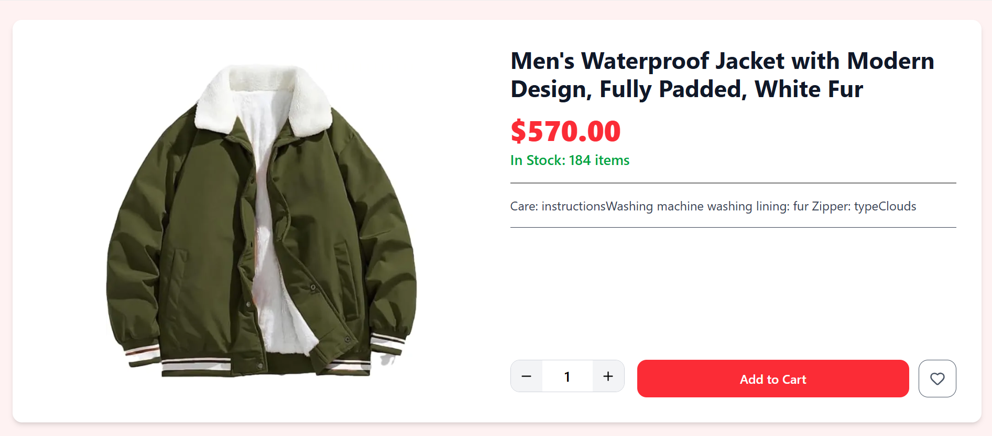
Product Details
• High-quality image zoom.
• Detailed specifications (Stock, Color, Size).
• Real-time stock status (e.g., 184 items left).

Slide 7
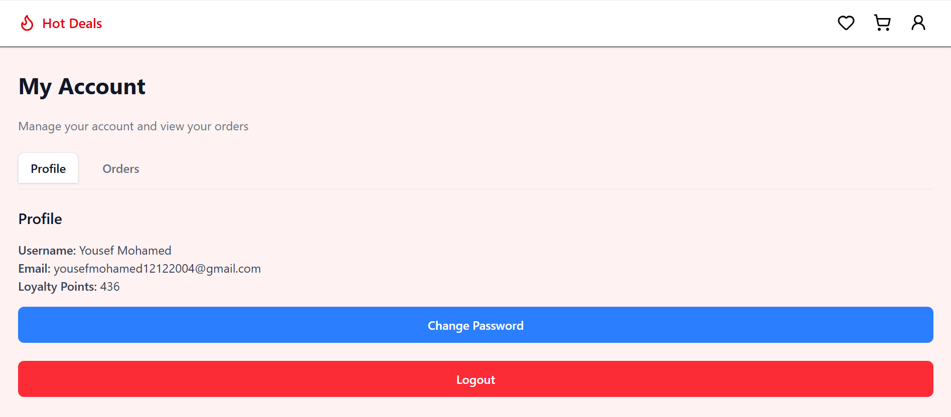
My Account & Security
• Personal Profile Management.
• Real-time Loyalty Points tracking.
• Order History access.

Slide 8
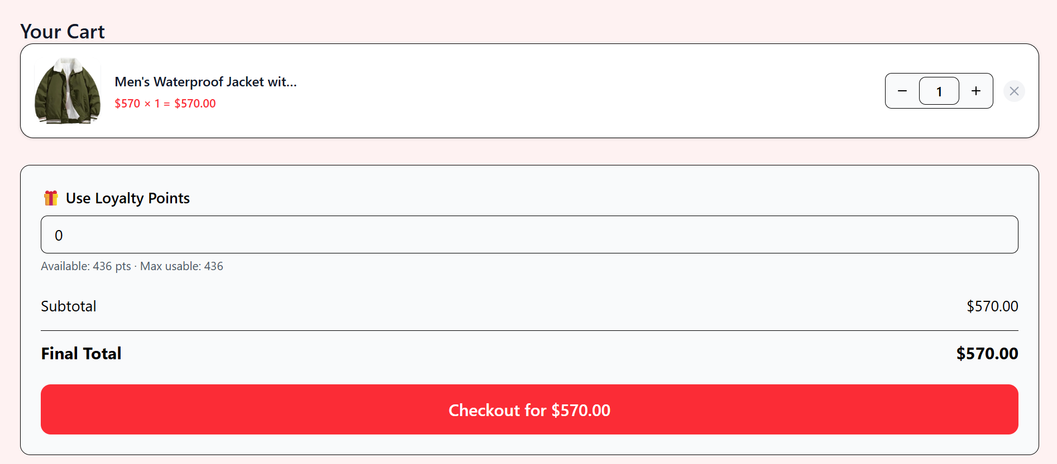
Smart Loyalty System ?
• The Competitive Edge:
• Spend 1000 EGP = Earn 1000 Points.
• Redeem: 1000 Points = 100 EGP Off.
• Seamless integration in Cart (As shown in image).

Slide 9
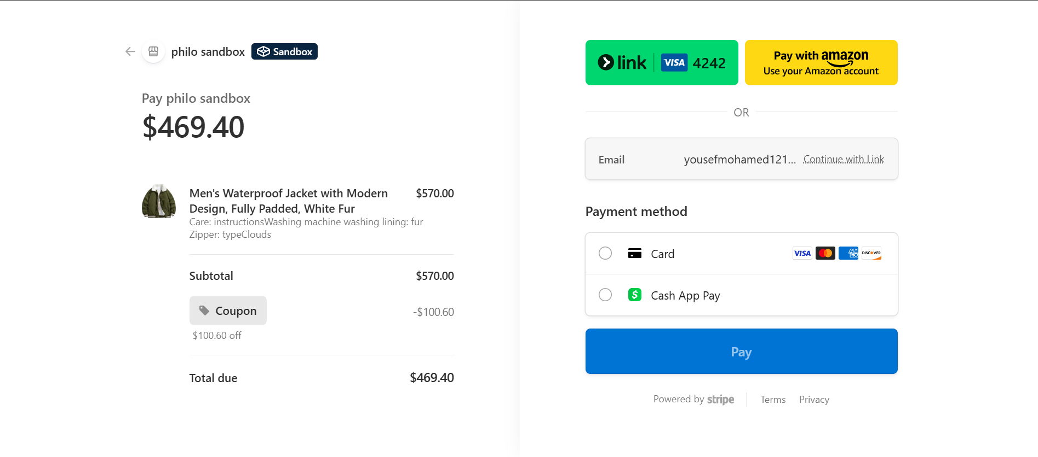
Secure Payments & Checkout
Powered by Stripe: Integrated with Stripe for world-class security and reliability.
Multi-Method Support: Accepts major Credit Cards (Visa, Mastercard, Amex), Link, Amazon Pay, and Cash App Pay.
Smart Checkout: Automated coupon application and transparent total calculation before payment.

Slide 10
Future Vision & Roadmap
Development:
Mobile App: Launching a native mobile application (iOS/Android).
AI Recommendations: Implementing an AI engine to suggest products based on browsing history.

Slide 11

Live Demo
The project is live at:
https://e-commerce-lake-chi.vercel.app/
Thank You!

